Slide 1
Triton Third-party Backends
Eikan, Wang(eikan.wang@intel.com)

Slide 2
Motivation
Goal - Extend Triton to support third-party out-of-tree backends
Philosophy - Minimize Triton maintenance effort
All changes are hosted in third-party backend code repo
Code-Free for the third-party backend on the Triton repo side

Slide 3
New Third-party Backend
Inherit from the common backend
https://github.com/openai/triton/blob/main/python/triton/common/backend.py
Key functions
Provides device runtime
Build kernel
Load kernel
Launch kernel

Slide 4
Add a New Third-party Backend to Triton
Add git submodule to Triton
triton/third_party/${new_backend}
Build Triotn w/ new backend
Set a particular env variable
Env Variable := ${prefix}_${suffix}
${prefix} = TRITON_CODEGEN
${suffix} = ${new_backend}
TRITON_CODEGEN_${new_backend}=1 python setup.py build
Install Triton w/ new backend
Better to install the new backend Python package to
triton/python/third_party/${new_backend_device_type}/
Build - TRITON_CODEGEN_${new_backend} python setup.py install

Slide 5
Compile Kernel for New Third-party Backend
Register new third-party backends to Triton
Key: ${new_backend_device_type}
Value: New backend class instance
Conclude new backend device type according to input tensors
“cuda”:
Any of the input tensors is cuda and NOT rocm(torch.version.hip)
All the input tensors are CPU and Pinned memory
“hip”: Any of the input tensors is cuda and rocm(torch.version.hip)
Other: return the device type of the input tensors
Get the new backend at runtime by the new backend device type
Automatically load “triton.third_party.${new_backend_device_type}” python package
device_backend_package_name = f"triton.third_party.{device_type}"
if importlib.util.find_spec(device_backend_package_name):
try:
importlib.import_module(device_backend_package_name)
except Exception:
return None
else:
return None

Slide 6
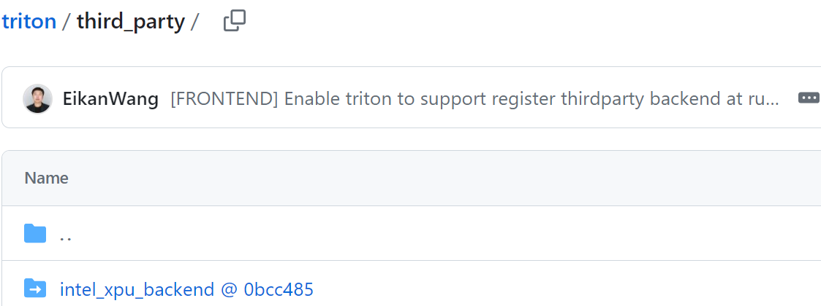
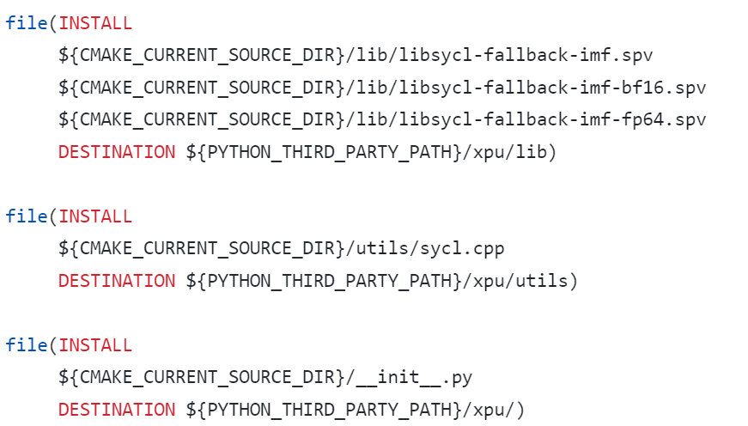
Intel XPU Backend for Triton
Add git submodule to Triton
triton/third_party/intel_xpu_backend
Build Triton w/ Intel XPU Backend
TRITON_CODEGEN_INTEL_XPU_BACKEND=1 python setup.py build
Install Triton w/ Intel XPU Backend
TRITON_CODEGEN_INTEL_XPU_BACKEND=1 python setup.py install
XPU Backend installs its python package to triton/python/third_party/xpu
Automatically load xpu backend at runtime
CMakeLists.txt

Slide 7
Intel XPU Backend for Triton
Key functions - XPUBackend
Provides device runtime
get_stream
get_device_properties
get_architecture_descriptor
get_current_device
set_current_device
Build kernel
add_stages
ttgir_to_spirv
spirv_to_spvbin
Load kernel
load_binary
Launch kernel
generate_launcher
__triton_launcher::launch

Slide 8
Intel XPU Backend for Triton
Conclude device type according to input tensors
_conclude_device_type
The device type of torch tensor on Intel GPU is XPU
Get third-party backend at runtime by the tensor device type - get_backend("xpu")
For the tirst time
import triton.third_party.xpu automatically
triton.third_party.xpu package initialization will register Intel XPU Backend to Triton automatically - register_backend("xpu", XPUBackend)
Later
Get the registered xpu backend directly

Slide 9
Open
How a third-party backend get the mlir context
Option 1: Get mlir context from libtriton
libtriton.so creates mlir context and registers some dialects, including arith, math, and so on
Do NOT register the dialects in the third-party backend and use the mlir context of libtriton.so
Option 2: Create and get mlir context in the third-party backend
Create an independent mlir context in the third-party backend
The interface between libtriton.so and the third-party backend is mlir binary
https://github.com/intel/intel-xpu-backend-for-triton/blob/main/python/csrc/intel_xpu_backend_for_triton.cc#L34

